Slide 1
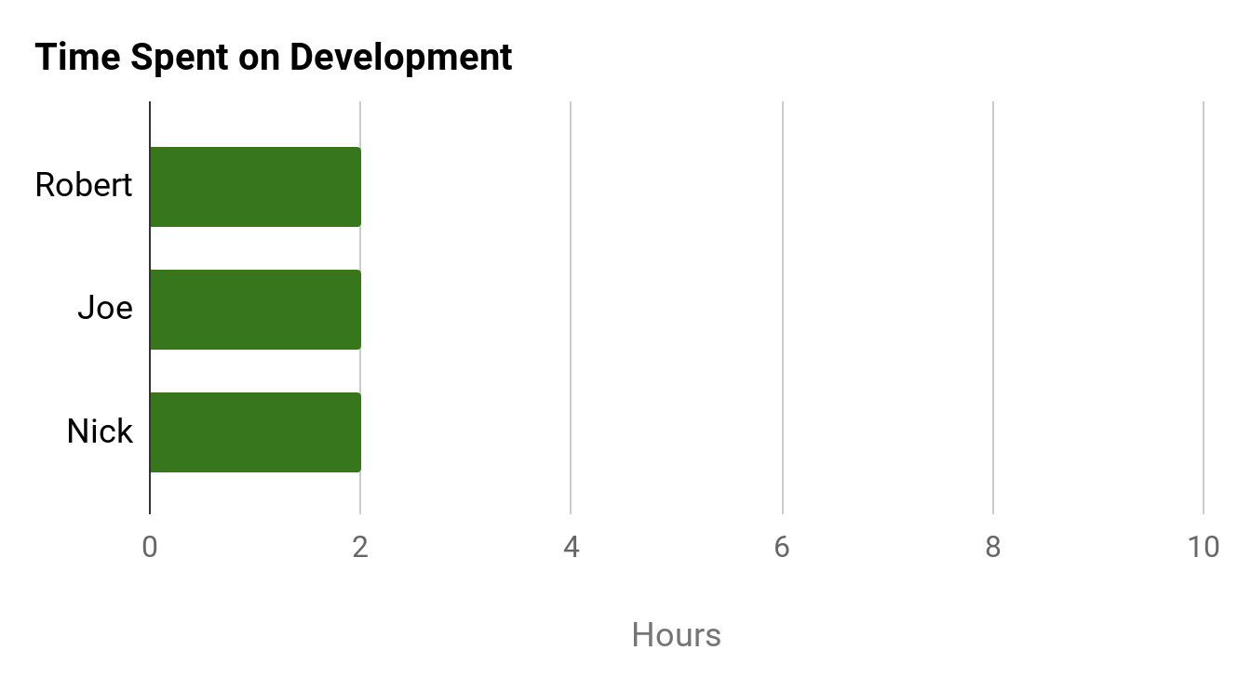
PROJECT DASHBOARD: HAX CMS MICROSERVICE
TEAM: #1
DATE: 23-FEB-2020
COMPLETED TASKS
On Target | At Risk | Attention Needed | Not Applicable
PROJECT STATUS
KEY PERFORMANCE INDICATORS
Successfully got Pandoc running locally
Reviewed PanDoc
Documented information about what we have and what we still need from Pandoc
On Target | At Risk | Attention Needed | Not Applicable
Overall: On Target
Time: On Target
CURRENT TASKS
Scope: On Target
Research how to run PanDoc
within Docker container
Compose survey questions
Complete Mid-Report
Cost: No Budget
RISK STATUS
Task | Progress
Requirement Gathering
Complete Gantt Chart
Potential User Surveys/Interviews
On Target | At Risk | Attention Needed | Not Applicable
ISSUES NEEDING ATTENTION
Risk 1: Lack of Developer Assistance
95%
Exporting file conversions
from the command line
Need list of extra Pandoc dependencies for the Docker container
Look online for pre-existing a Pandoc Docker Container
Risk 2: Project Pace
75%
Risk 3: GitHub Compatibility
Risk 4: Scope Creep
50%

